Slide 1

NET theragnostics-2
Prof John Buscombe

Slide 2
Introduction
The present guidelines for PRRT
Evidence for use of PRRT
  Y-90
  Lu-177
Level of expected evidence
Results of NETTER-1
Recent studies

Slide 3
Levels of evidence from clinical trials
Phase 1 study
  Proof of concept and max tolerated dose
  Normally 20-30 patients
Phase 2 study
  Determination of efficacy
  Normally 50-100 patients
Phase 3 study
  Multi-centre RCT compared to standard treatment
  May need 200-1000 patients

Slide 4
Why PRRT
We know radiolabelled somatostatin localise to NETs mainly via SSR2 receptor
If you can see tumour using gamma emitter then by changing to alpha or beta emitter can treat
Reduced collateral damage c/w DXT
True personalised/precision medicine

Slide 5
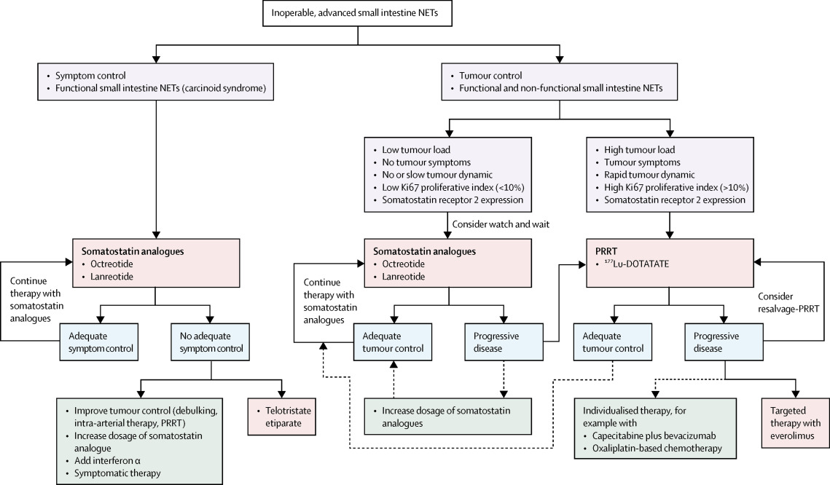
ENETs GEP guidelines

Slide 6
Treating NETs general principles
Establish diagnosis
Establish extent of disease
Syndromic vs non syndromic
Use of first line treatments
Natural history of disease*
Expectations of treatment
Quality of life
Deciding when NOT to treat/ STOP treatment

Slide 7
Radiopeptides
Based on somatostatin system
Peptides converted from commercial sources:
  Lanreotide
  Octreotide
  Octreotate
  OctreoNOC
  SSR antoagonists
Normally DOTA linker
Isotopes In-111, Y-90, Lu-177

Slide 8
Affinity of radiolabelled somatostatin analogues to somatostatin-receptors
Radiopharmaceuticals
Sst1
Sst2
Sst3
Sst4
Sst5
Native somatostatin SS-28
¹¹¹In-DTPA-octreotide
⁹⁰Y-DOTA- Tyr³octreotide (⁹⁰Y-DOTATOC)‏
⁹⁰Y-DOTA- Tyr³octreotate (⁹⁰Y-DOTATATE)‏
⁹⁰Y-DOTA-lanreotide (⁹⁰Y-DOTALAN)‏
¹⁷⁷Lu-DOTA- Tyr³ octreotate (¹⁷⁷Lu-DOTATATE)
5.2±0.3
>10000
>10000
>10000
>10000
>10000
2.7±0.3
22±3.6
11±1.7
1.6±0.4
23±5
15
7.7±0.9
182±13
389±135
>1000
290±105
>10000
5.6±0.4
>1000
>10000
523±239
>10000
453
4.0±0.3
237±52
114±29
187±50
16±3.4
547
IC₅₀ ± SEM, nM
Reubi JC et al. Affinity profiles for human somatostatin receptor subtypes SST1-SST5 of somatostatin radiotracers selected for scintigraphic and radiotherapeutic use. Eur J Nucl Med. 2000, 27:273-82.
de Jong M et al. Comparison of ¹¹¹In-labeled somatostatin analogues for tumor scintigraphy and radionuclide therapy. Cancer Res. 1998, 58:437-41.
Notes:
By changing some of the amino-acids constituting somatostatin, a variety of peptides have been synthesized that bind the various somatostatin receptors.
Emphasis was given to the sst2 receptor, which is more often over-expressed by tumour cells.
A high affinity, in the nanomolar range, is considered mandatory before any further study.

Slide 9
Preclinical development
De Jong M et al. Somatostatin receptor-targeted radionuclide therapy of tumors: preclinical and clinical findings. Semin Nucl Med. 2002, 32:133-40.
Notes:
Most preclinical studies have been performed in rats grafted with human tumour cells or with the rat pancreatic tumour CA20948 that allows for evaluation of activity against metastases that occur primarily in the liver.
In this model, several analogues could be evaluated and DOTA-TATE appear as the best vector as shown by biodistribution studies and experimental peptide receptor radiotherapy.
Kidney uptake is a concern, but animal models are not entirely satisfactory as male and female mice do not show the same uptake levels and this level is lower in rats.

Slide 10
Practical points
Patient selection
Positive study on In-111 oct, Tc-99m DOTANOC or Ga-68 DOTATATE
Must have progressive disease on CT or MRI or symptoms not controlled by sandostatins
Tumour related WHO performance status 0,1
If on LAR time treatment for week before or after injection as plasma levels at their lowest
If sub cut stop 24 hours

Slide 11
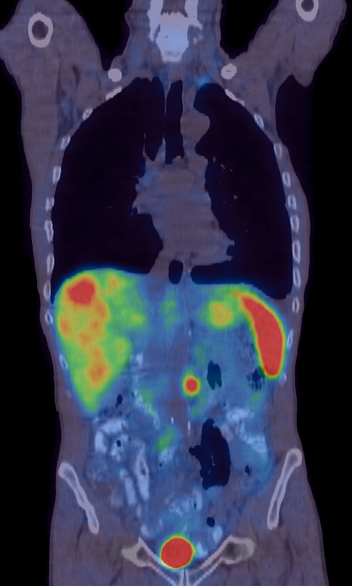
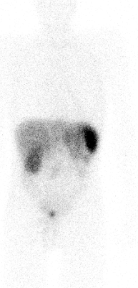
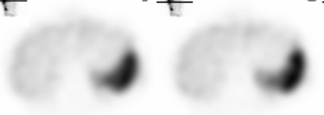
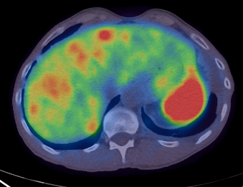
Ga-68 PET/CT more lesions than
In-111 Oct
In-111 Oct WB
Ga-68 PET/CT
SPECT

Slide 12
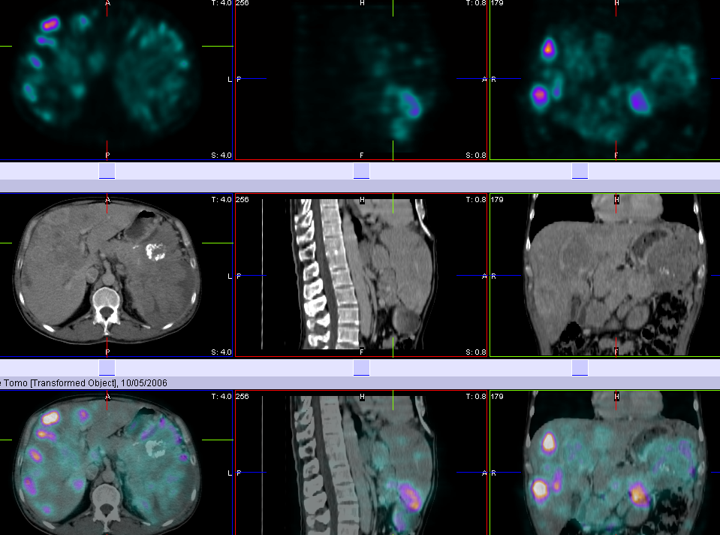
Tc-99m HYNIC octreotide
Foregut, pancreas – non-secretor, NECLM (WHO 2)

Slide 13
Y-90 octreotate
Developed in Basel
Higher affinity for SSR2 than octreotide
Minimal side effects as renal (if co-administration of arginine/lysine) and bone marrow uptake low
Patients treated in Poland, UK and Germany
Found to have a higher than expected long term bone marrow toxicity (MDS and ALL)

Slide 14
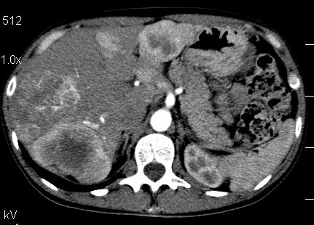
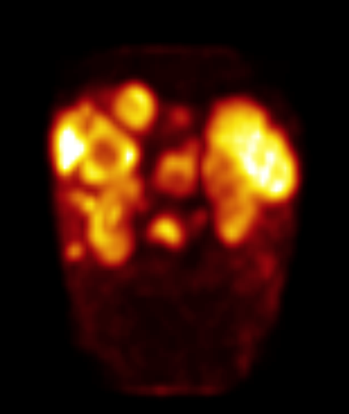
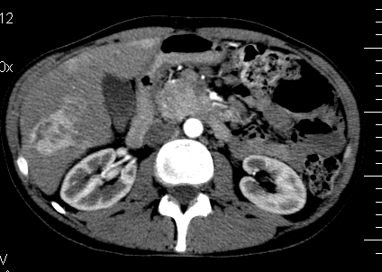
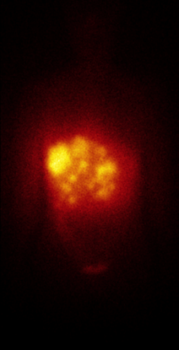
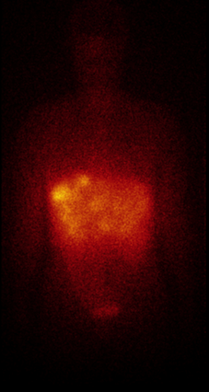
Foregut, pancreas – secretor (gastrinoma)
NECLM (WHO 2)

Slide 15
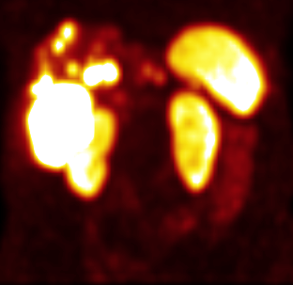
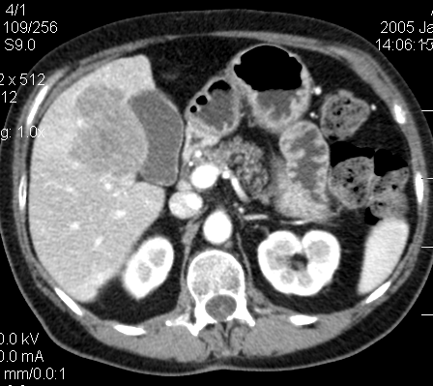
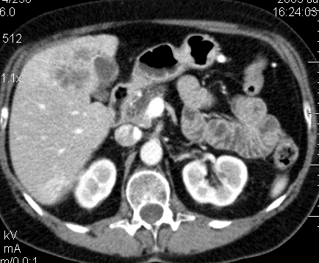
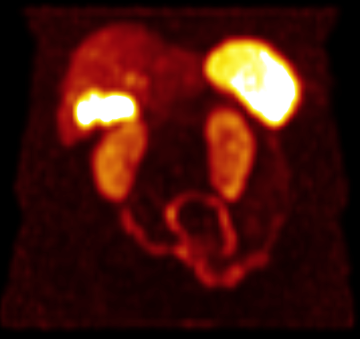
61 yrs old female;
FPI, WHO 2, G2;
CS IV, nonsecretor
Initial SRS (⁹⁹Tc TOC)
Initial CT
CT 12 M
after PRRT
SRS 12 M
after PRRT,
(⁹⁹Tc TOC)
15

Slide 16
Treatment with Y-90 DOTATATE
Cwikla et al (Ann Oncol 2010)
35 patients with proven GEP-NET
All treated patient had evidence of PD before therapy
4x3-4GBq Y-90 DOTATATE with amino-acid cover 12 weeks apart
Response measure by CT and symptom relief
Good correlation between symptom relief and survival
Correlation with imaging less clear

Slide 17
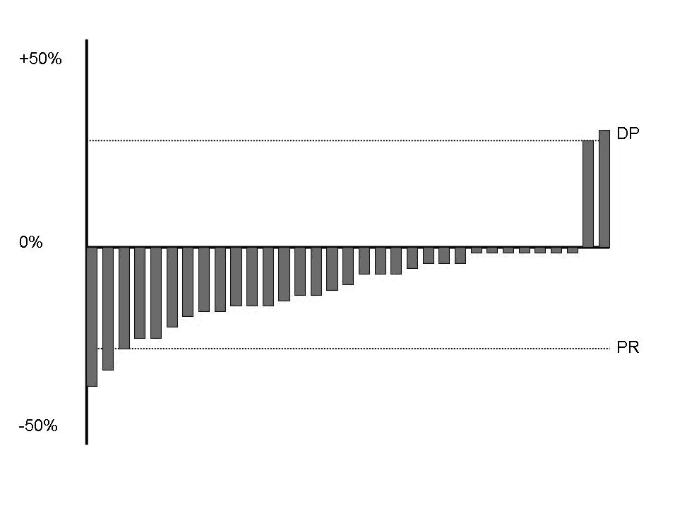
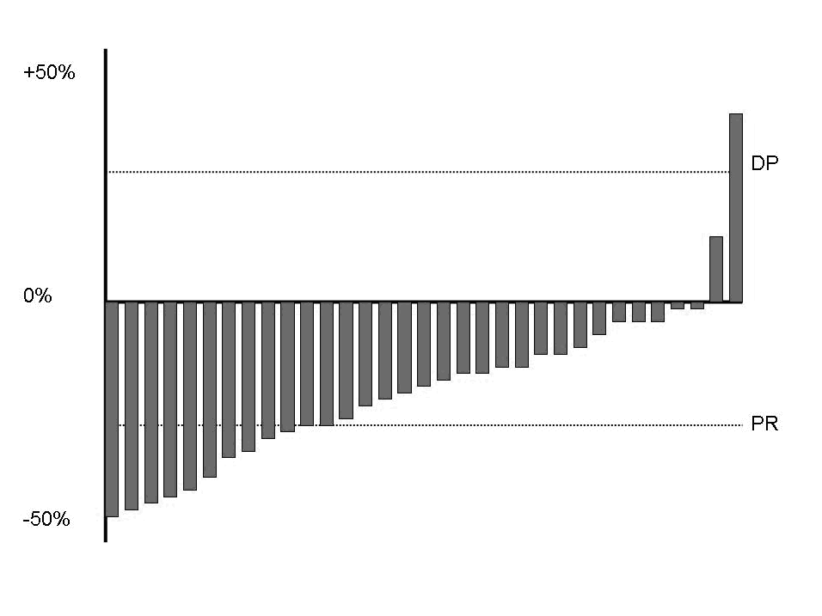



What is a response with Y-90 Cwikla et al Evidence for the bystander effect?
Waterfall plot at 6 weeks Waterfall plot at 6 months
Pre-therapy 6 months post last cycle 12 months after last cycle

Slide 18
Lutetium-DOTATATE development
From a somatostatin-receptor ligand to a registered dru
A series of analogues synthesized and studied by academic teams in various tumour models (mice and rats), work in Rotterdam and Basel
Successfully transferred to the clinic by academia for imaging (indium-111, gallium-68) and therapy (yttrium-90, lutetium-177)
Thousands of patients included in clinical trials and treated by compassionate use not just in Europe but worldwide
A concern: risks of kidney failure and some myelotoxicity
Good phase II data but until recently phase III data lacking
Now approved worldwide
Notes:
Peptides binding somatostatin-receptors have been considered for many years first as neuroendocrine tumour imaging agents with the indium-labelled octreotate.
A series of analogues have been synthesized and studied by various academic teams in various tumour models in mice and rats as the so-called peptide receptor radiotherapy (PRRT) approach
Some coupouns have been successfully transferred to the clinic by academia for imaging, labelled with indium-111 and more recently with gallium-68 for PET imaging and therapy labelled with yttrium-90 or lutetium-177
Thousands of patients have been included in clinical trials or treated by compassionate use, revealing some concern: the risks of kidney failure and myelotoxicity, but also a very interesting efficacy
However to really offer this therapeutic opportunity to patients in a routine context, a phase III registration trial was needed that, finally, a company, AAA, completed

Slide 19
Lu-177 Octreotate
Developed by Krenning
First good report in JCO 2005
151 patients treated with cum activities of 22-30 GBq of Lu-177 octreotate
Given with amino acid renal protection
Toxicity bone marrow (2%) and in some men reduction in testosterone
Follow up data in 125 patients

Slide 20
Lu-177 in GEP (Krenning-JCO 2005)

Slide 21
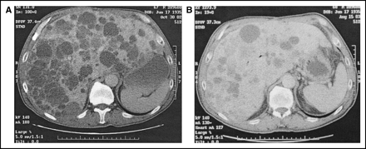

Krenning et al JCO 2005

Slide 22
Lu-177 octreotate (n=310) Kwekkeboom JCO 2008-follow-up paper
Results by disease type. Please note PET=pancreatic endocrine tumour
Mid gut NET including carcinoid n=188
  1% CR, 22% PR, 17% MR, 42% SD, 20%DP
PET non func n=72
  6% CR, 36% PR, 18%MR, 26% SD, 14% DP
PET func n=19
  0% CR 60% PR, 20% MR, 30% DS, 10% PD

Slide 23
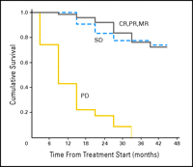
Survival post Lu-177 oct n=310
Kwekkeboom JCO 2008

Slide 24
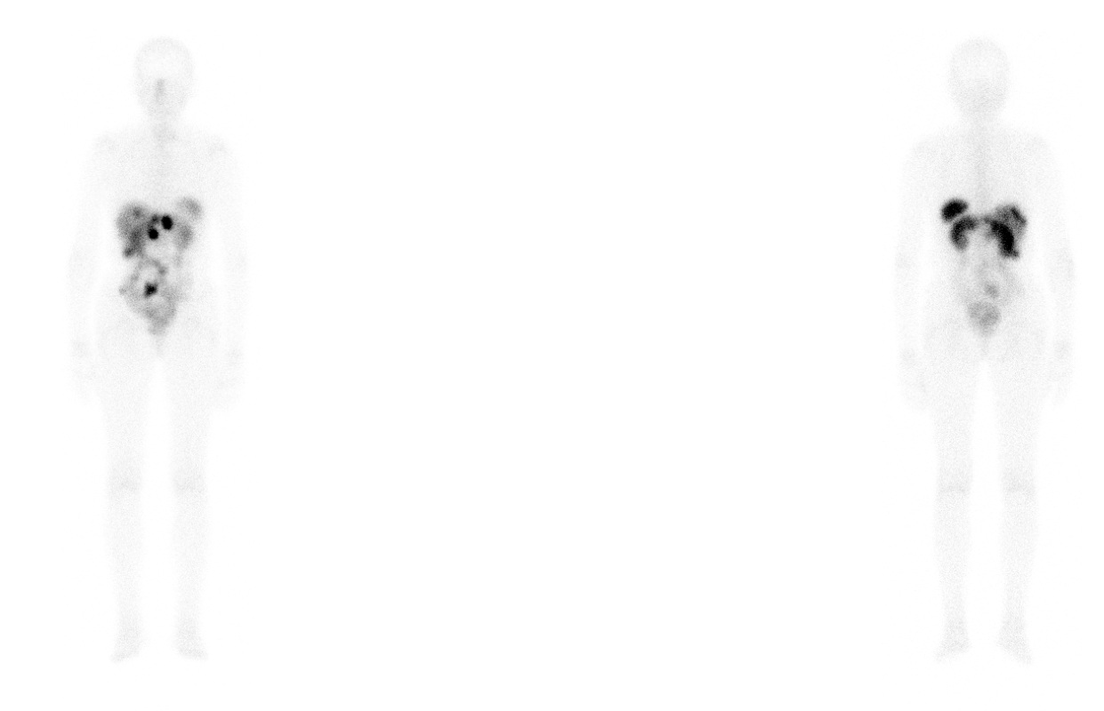
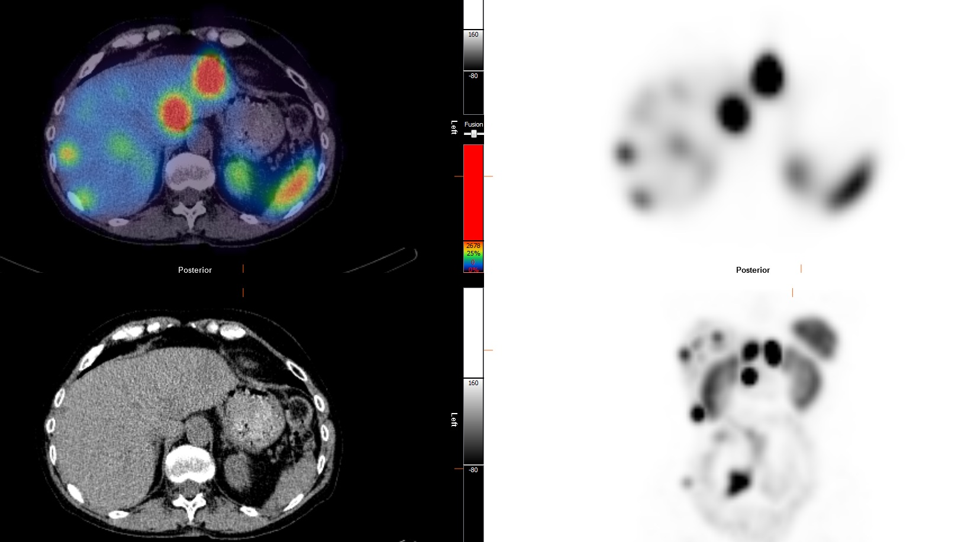
Post therapy with Lu-177tate
Image courtesy of Dr S Navalkissoor Royal Free Hospital London

Slide 25
PPRT DOTATATE-Clin Med 2011
Navilkissor et al 2011
Author (n) | CR | PR | SD | DP | Symptom relief
Baum (75) | 0 | 28 | 39 | 8 | 64
Cwikla (57) | 0 | 14 | 44 | 0 | 51
Toupanakis (85) | 0 | 11 | 66 | 11 | 62
TOTAL (217) | 0 0% | 49 23% | 149 69% | 19 8% | 167 77%
Y-90
Author (n) | CR | PR | SD | DP | Symptom relief
Kwekenboom (310) | 5 | 86 | 158 | 61 | 21/36
Gabriel (55) | 0 | 15 | 27 | 13
Total (365) | 5 2% | 101 27% | 185 51% | 74 20% | 58%
Lu-177

Slide 26
Meta-analysis Kim et al E JNM 2015
Reviewed papers reporting Lu-177 PRRT in NET
Assessed as having proper output data
Identified 6 papers, 3 papers prospective
Most used RESCIST criteria
Single German paper used SWOG criteria
Largest paper n=274 from Netherlands, smallest n=18 from Switzerland

Slide 27
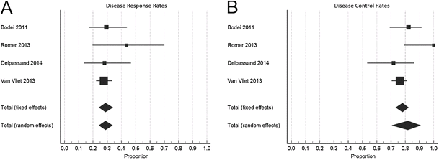
Forest plots of 356 pts
Forest plots of proportions of disease response rates (a) and disease control rates (b) in RECIST 1.0 criteria group
Overall response rates 29% had disease size reduction >50%, for disease control (SD, PR and CR the overall rate is 81%

Slide 28
Caution in PRRT
Severi et al EJNMMI 2013 Milan, Italy
52 patients mixed NETs treated with PRRT
27.7 GBq in 5 treatments
FDG PET positive in 57% of G1 NET and 66% in G2 NET
Disease control (SD, PR, CR FDG+ 79%, FDG-95% (n.s.)
Mean PFS FDG+ 20 months, FDG – 32 months (p=003)

Slide 29
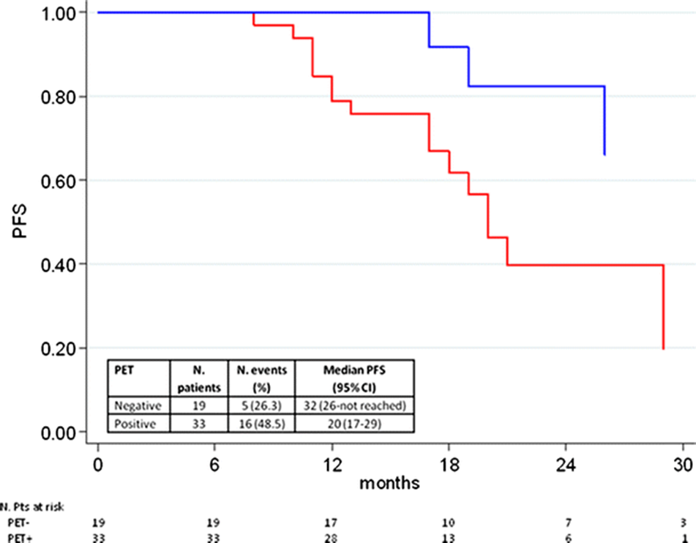
Severi et al EJNMMI-2013
FDG -
FDG +

Slide 30
The problem of evidence based medicine and PRRT
Evidence based medicine seen as the gold standard and the key to health care funding.
Many health systems under financial stress as population ages
So those who pay the bills balance data from different trials in different disease
So NET competes for same pot of money as chemo in other cancers
Payers look for evidence from phase 3 RCTs
Many centres also need outcome data eg cost per year saved

Slide 31
The first phase III RCT in NETs
Randomized multicentre phase III study comparing ¹⁷⁷Lu-DOTATATE + Sandostatin® LAR Depot (LAR octreotide) 30 mg to LAR octreotide 60 mg in patients with grade 1-2, inoperable, progressive under LAR octreotide MID GUT neuroendocrine tumour 30 mg
4 administrations of 7.4 GBq de ¹⁷⁷Lu-DOTATATE every 8 weeks (LAR octreotide 30 mg)
229 patients included showing a 79 % reduction of progression or death risk (p < 0.0001)
Overall response : 18 versus 3 % (p = 0.0008)
Overall survival (interim analysis): 13 vs. 22 deaths (p = 0.0186)
Reasonable tolerance ++nausea for 7-10 days

Slide 32
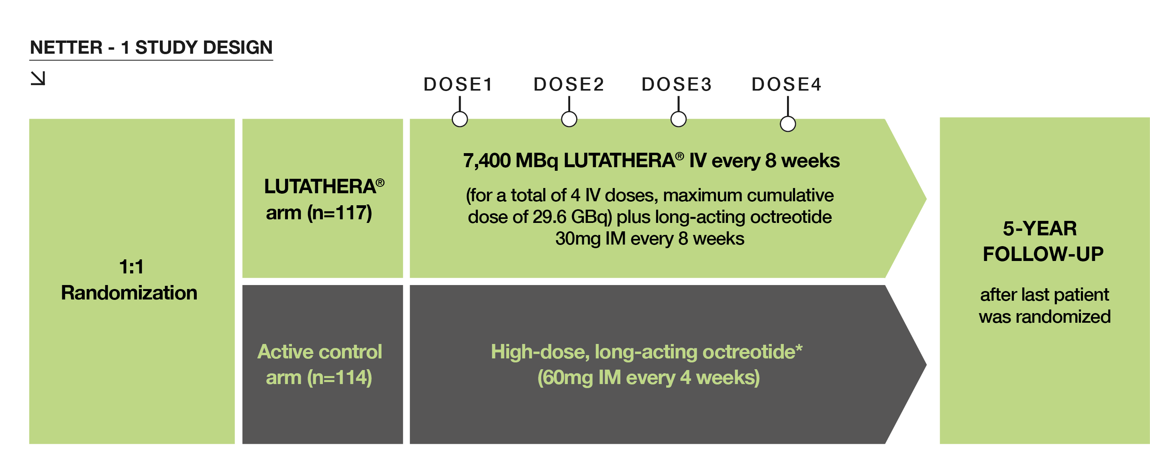
NETTER-1: Study objectives and design
Aim: Evaluate efficacy and safety of Lutathera® + SSAs (best supportive care) vs octreotide LAR 60 mg in patients with inoperable, SSTR-positive midgut NET, progressive on octreotide LAR 30 mg
Design: International, multicentre, randomised, comparator-controlled, parallel-group
Primary endpoint: PFS; response according to RECIST, every 12 weeks

Slide 33
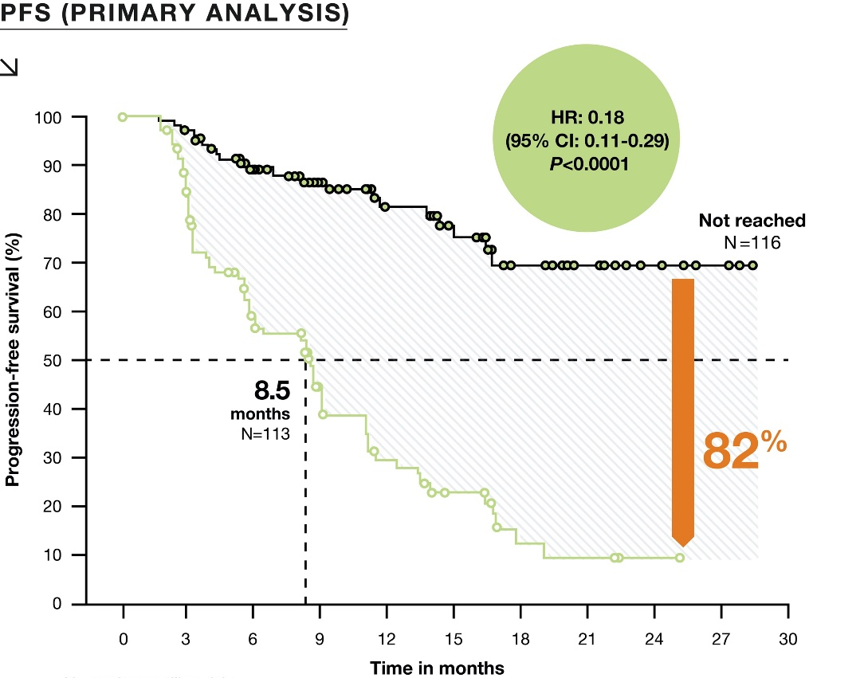
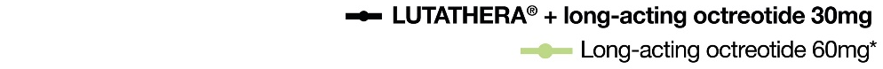
NETTER-1: Progression-free survival
At the pre-specified analysis
cut-off date (24 July 2015)
21 events in the Lutathera® group vs
70 in high-dose octreotide LAR* group
Median PFS for Lutathera® was not reached at the time of the primary analysis vs 8.5 months with high-dose octreotide LAR*
HR for the LUTATHERA® arm was
0.18 (95% CI: 0.11–0.29), indicating an 82% reduction in the risk for a patient to progress or die with Lutathera® vs control (p<0.0001)

Slide 34
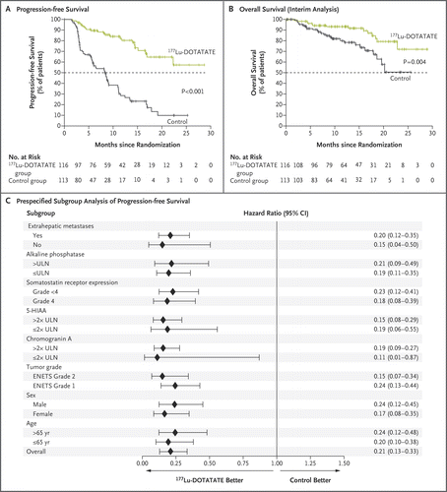
Strosberg et al NEJM 2017 in press
Phase III Lu-177 DOTATATE vs high dose octreotide

Slide 35

Levels of evidence from clinical trials
Phase 1 study
  Proof of concept and max tolerated dose
  Normally 20-30 patients
Phase 2 study
  Determination of efficacy
  Normally 50-100 patients
Phase 3 study
  Multi-centre RCT compared to standard treatment
  May need 200-1000 patients

Slide 36
Giving PRRT-general principles
Discuss treatment with patient
Obtain consent
Give anti-emetic eg odansetron 8mg
15 minutes later start amino acid + fluids to give 30g lysine and 2 litres over 6 hours
45 minutes after amino acids start give Lu-177 DOTATATE over 20-30 minutes
Repeat 3 more times 8 weeks apart

Slide 37
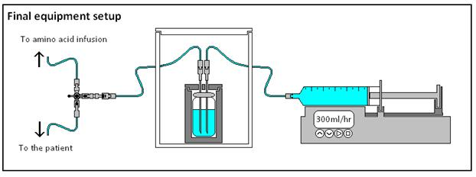
Infusion system

Slide 38
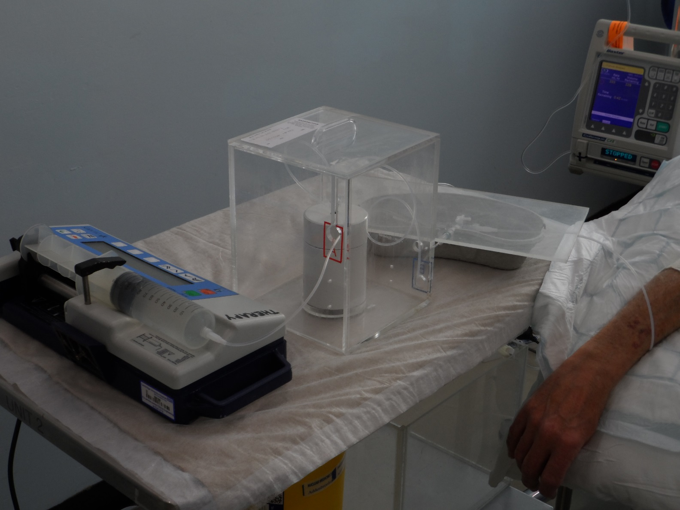
Infusion system

Slide 39
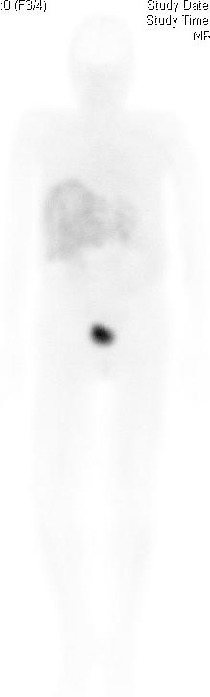
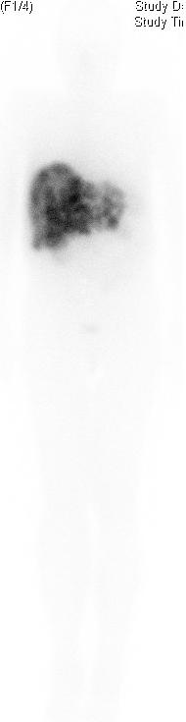
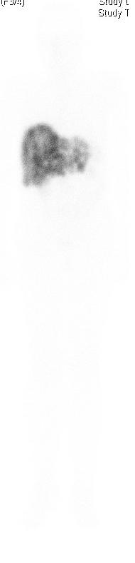
Lu-177 DOTATATE- post therapy imaging
3 hours post injection 24 hours 7 days

Slide 40
Possible problems-PRRT
Carcinoid crisis-can occur in unstable patients
Tumour lysis syndrome can be seen in patients with large tumour masses
Liver failure if> 50% of the liver replaced by tumour
Hyperkalaemia from the amino-acid infusion
Renal impairment seems more common if kidney obstructed
Bone marrow sensitivity not related to bone mets or previous chemotherapy

Slide 41
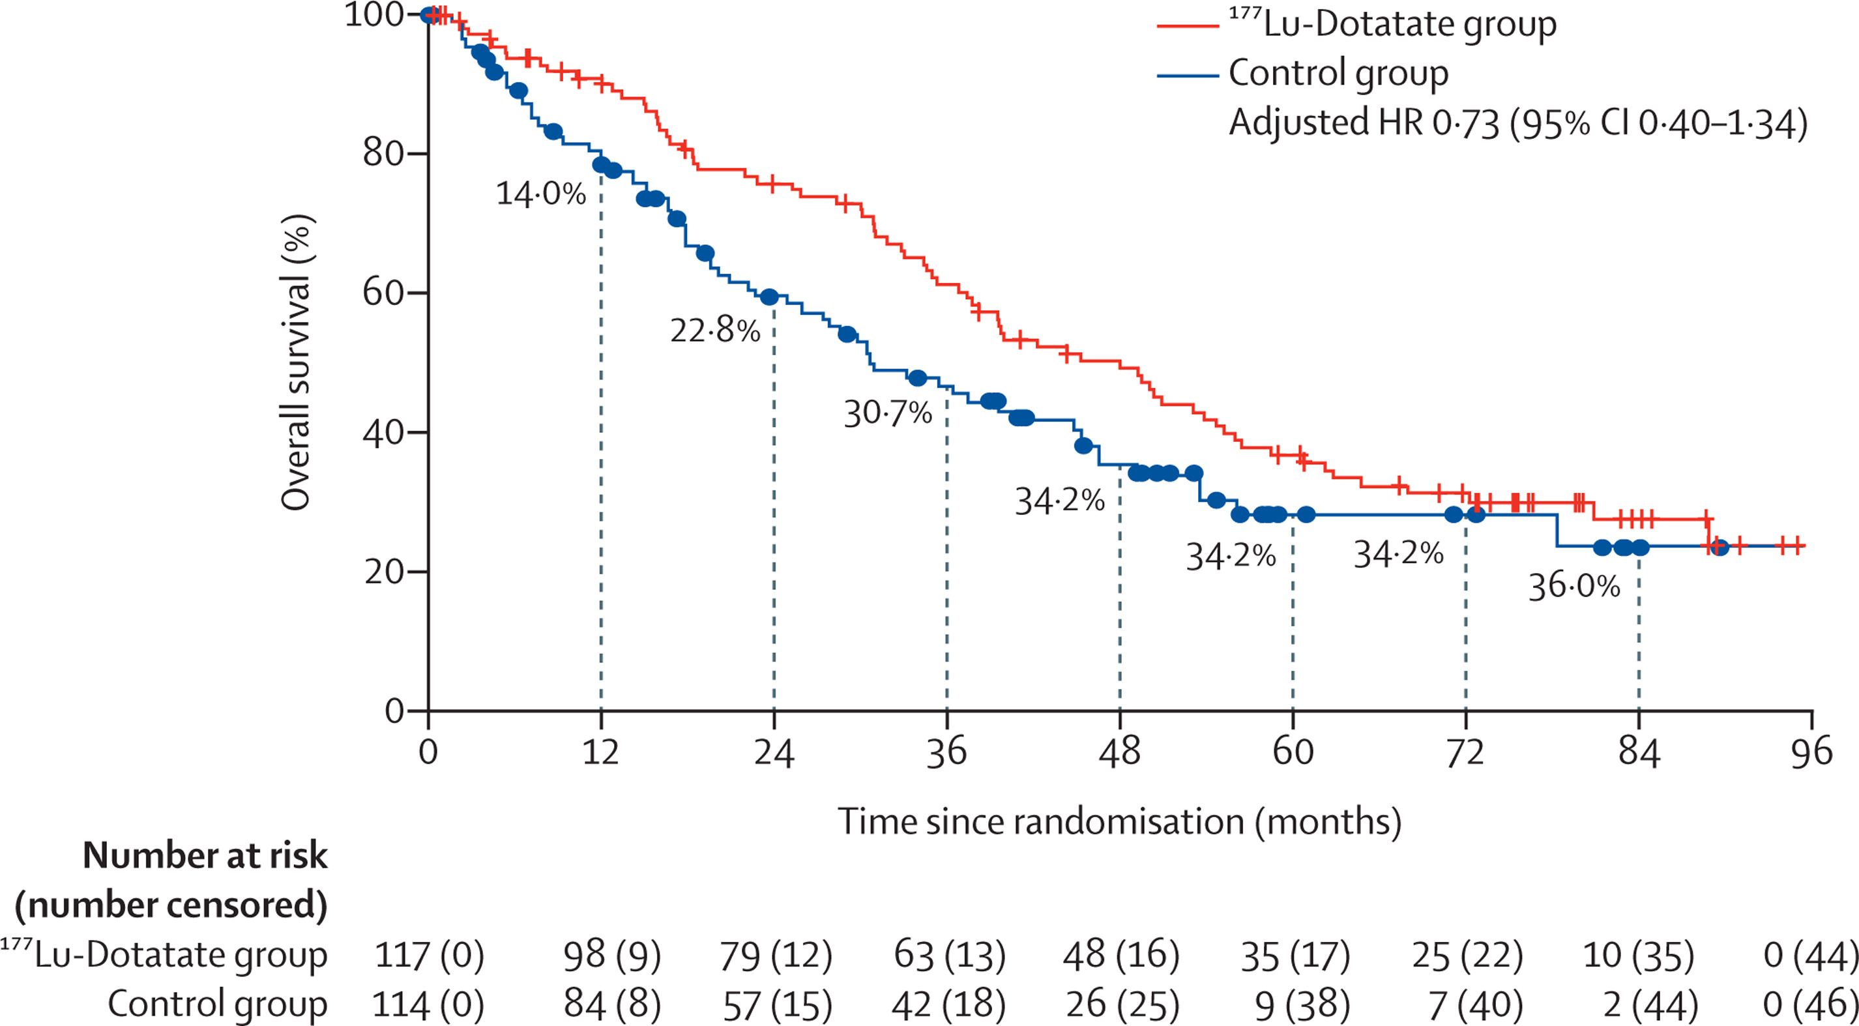

Overall survival long term results
NETTER1 long term study
Most patients in control group offered ¹⁷⁷Lu-Dotatate after end of study

Slide 42
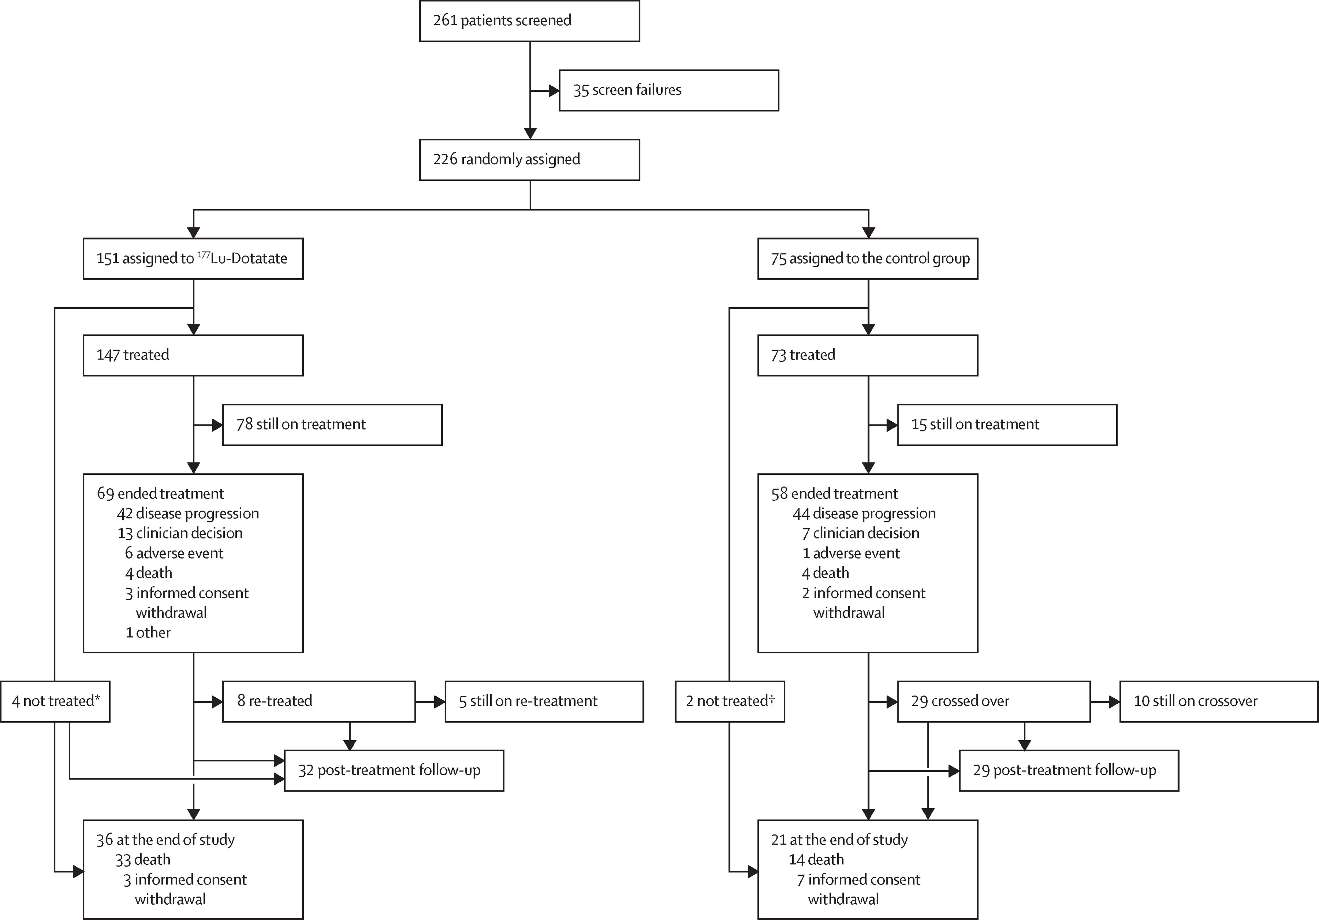
Use of PRRT as first line treatment
NETTER 2 trial
Multicentre randomised controlled trial
Newly diagnosed G2 and G3 NETs with Ki-67>10%
226 patients studies in 45 European and North American centres
Of these 2/3 received 4x Lu-177 DOTATATE and Octreotide and 1/3 Octreotide LAR 60mg every 4 weeks
Primary end point was progression free survival

Slide 43
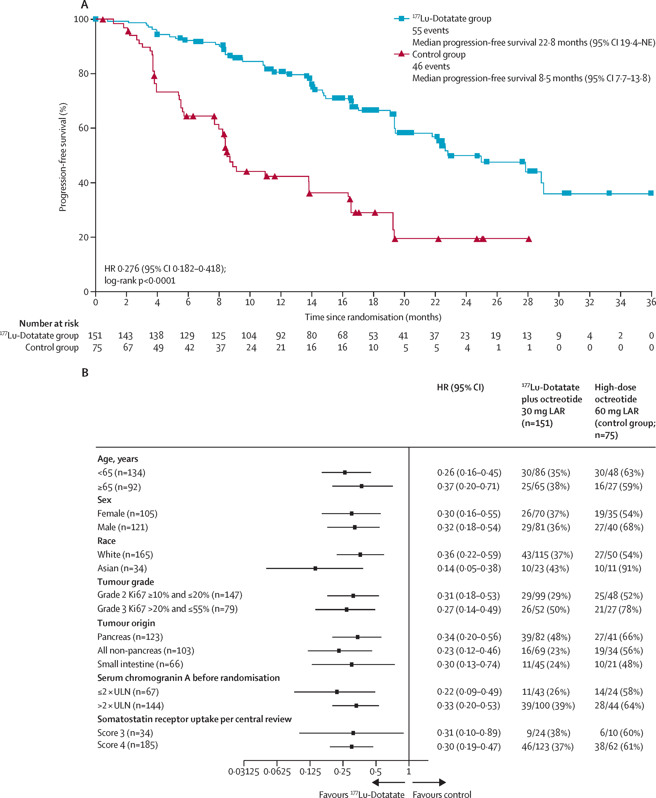
NETTER-2 trial
Early results published in the Lancet July 2024
Results demonstrated that median PFS in the placebo group was 8.5 months
Median PFS in the Lu-177 DOTATATE group was 22.8 months
No tumour associated deaths in either group
Results similar independent of stage and tumour grade
Over 93% of patients in both groups reported adverse events mainly minor
No evidence how this may affect overall survival

Slide 44
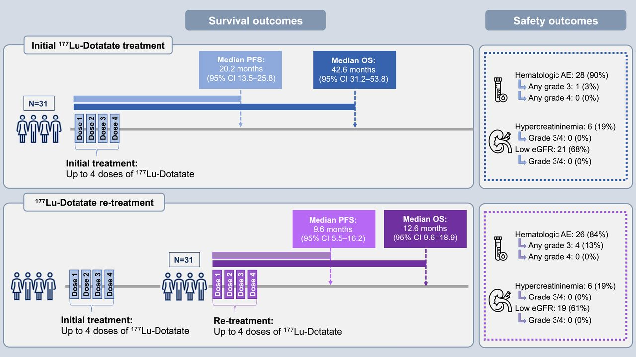
Extended use of Lu-177 DOTATATE
The effect of a repeat cycle of 4x74 GBq Lu-177 DOTATATE was assessed in Phase II study in Texas by Delpassand et al JNM 2024
This study was performed on 31 patients who had a good initial response to Lu-177 DOTATE but then progressive disease > 6 months after last PRRT
Single site non-randomised study, patients offered further 4 treatments of 7.4BGq Lu-177 DOTATATE
Second treatments well tolerated
However, treatment response shorter with mean PFS of 9.6 months compared with 22 months for their first treatment
New phase 3 of 2 additional cycles vs 4 cycles proposed

Slide 45
What about a dosimetric approach
No prospective trial
Several retrospective trials have tried to correlate response with tumour dosimetry
Latest from Milan by Maccauro et al EJNMMI 2024
Reviewed tumour radiation dose of 42 patients treated with 4x7.4GBq Lu-177 DOTATATE
Best median PFS obtained if tumour dose per cycle was >10 Gy
Worst PFS if there was a significant reduction in tumour radiation dose between cycle 1 and 4 (?dedifferentiation)
Results did not agree with prior French and Belgian studies where >30Gy needed for response

Slide 46
Combination therapy
The idea is to combine Lu-177 DOTATATE with a chemotherapy of immunotherapy to improve efficacy
A number of small single site non-randomised trials reported including
Thakral et al combined Lu-177 DOTATATE with capecitabine and temazolimide in 10 patients with GEP NETs The treatment was “well tolerated” but no outcome data (BJR 2018)
Kim at al combined Lu-177 DOTATATE and Nivolumab an anti PD1 antibody in 7 patients with lung NET with a response seen in 3/7 patients (J Immun Ther 2020)
Nicolini et al looked at combining Lu-177 DOTATATE with capecitabine in a multi-centre trial in Italy. 37 patients treated including G3 tumours and those who were FDG avid, 6 patients had marked bone marrow toxicity and the mean PFS was 31 months (EJNMMI 2021)

Slide 47
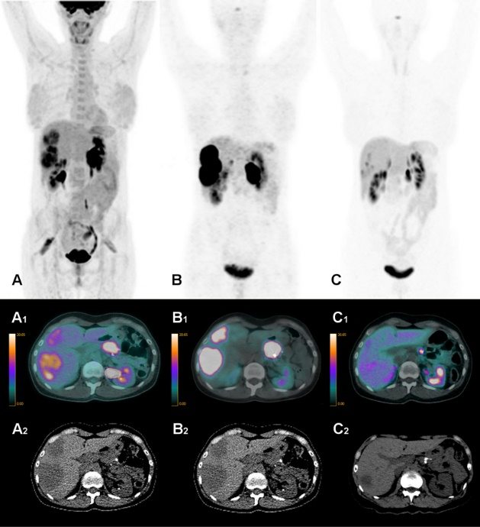
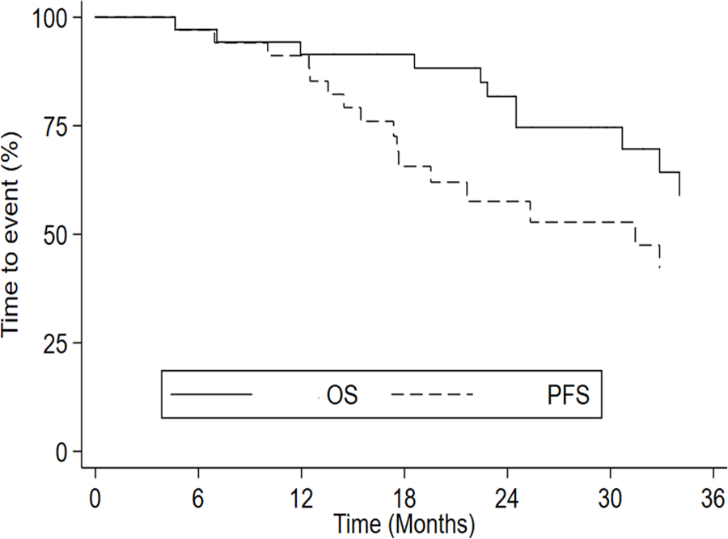
Capecitabine and
Lu-177 DOTATATE
45 female FDG avid G2 pancreatic tumour treated with 5 cycles of Lu-177 DOTATATE and capecitabine
Capecitabine was developed in the 1990s and works by stopping DNA repair caused by radiation
Therefore can enhance the effect of Lu-177 DOTATATE
In Italian phase II trial the combination was used in FDG avid G1-G3 GEP NETs-Nicolini et al

Slide 48
Does capecitabine really help
Satapathy et al 2025 JNM
New study from India
Single site randomised phase II trial
Lu-177 DOTATATE vs Lu-177 DOTATATE and capecitabine
36 patients in each arm of the study
Median PFS was 30 months in both arms of the study
Not able to calculate OS
In RCT capecitabine does not offer an advantage

Slide 49
New area of research
Look at new peptides
Includes SSR antagonists
Also is there a role for alpha emiters
If so which isotope best
What about MIBG?

Slide 50
Use of SSR antagonists
Not new
Have been investigated over past 15 years
Theoretical advantages include lower internalisation, higher receptor binding and lower disassociation rates
Various compounds investigated including LM3 and JT11
Different linkers also used such as NODAGA
Comparison of DOTATATE and antagonists may not produce consistent results due to non-homogenous nature of the NETs within the same patient

Slide 51
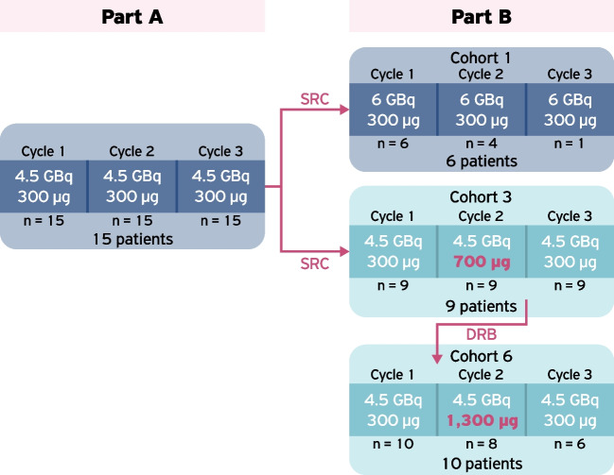
Lu-177 satoreotide in NETs
Wild et al Phase I/II prospective trial in Europe, North America and Australia EJNMMI 2023
Fixed radiation activity over 3 cycles varied peptide concentration from 300 mcg to 1200 mcg
25 patients studied of which 6 received a 4th cycle of Lu-177 satreotide

Slide 52
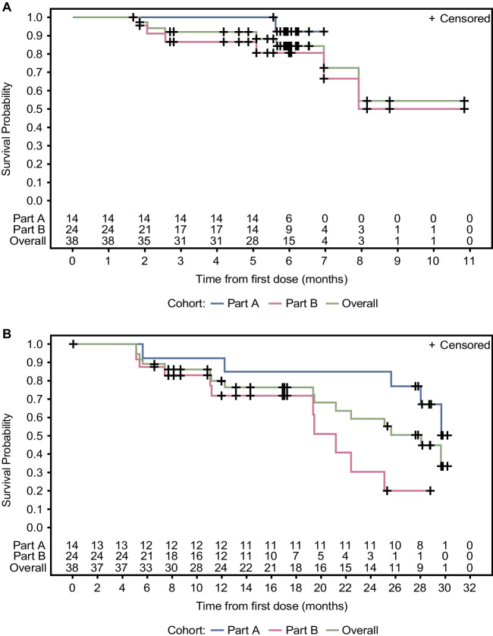
Results
Generally, well tolerated
37% had grade 3 or 4 haemotological toxicity
About half of these patients could not complete treatment
No significant renal toxicity
Good response seen objectively (A) and by investigator (B)
Question of phase III RCT

Slide 53
Alpha emitters
Lu-177 DOTATATE has been shown to improve survival
However, even after treatment the volume of tumour remains high and is often similar to before treatment
If more Lu-177 DOTATATE is administered then there is an increased risk of toxicity
To get more tumour kill then alpha emitters may provide best answer
However, if attached to DOTATATE likely to result in renal toxicity and renal failure
Therefore, most researchers looking at somatostatin antagonists with less renal and liver uptake
Isotopes being considered are Ac-225, At-211, Pb-212 and Cu-67
Most studies are pre-clinical but phase I and II clinical studies likely to emerge over next 5 years however Ac-211 DOTAMTATE in phase II trials in NETs by Radiomedex and Orano who were bought by Sanofi for 150 million Euros in 2024

Slide 54
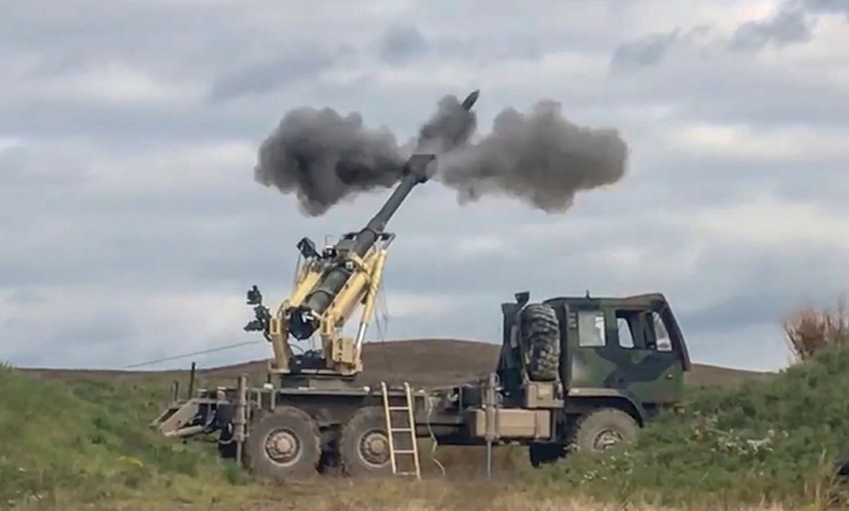
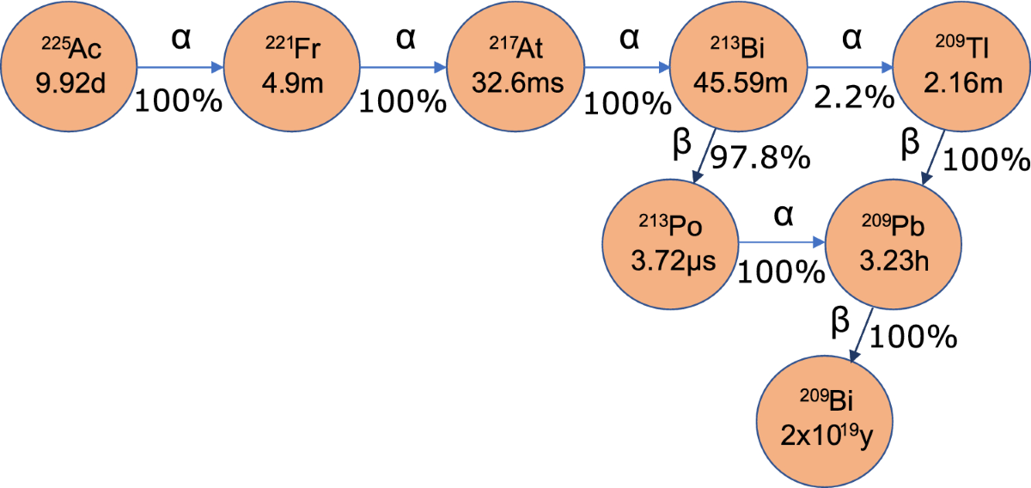
Potential issues with Ac-225 PRRT
Is alpha recoil a good thing or bad thing or a bit of both?
Does all this stay in the NET cell?

Slide 55
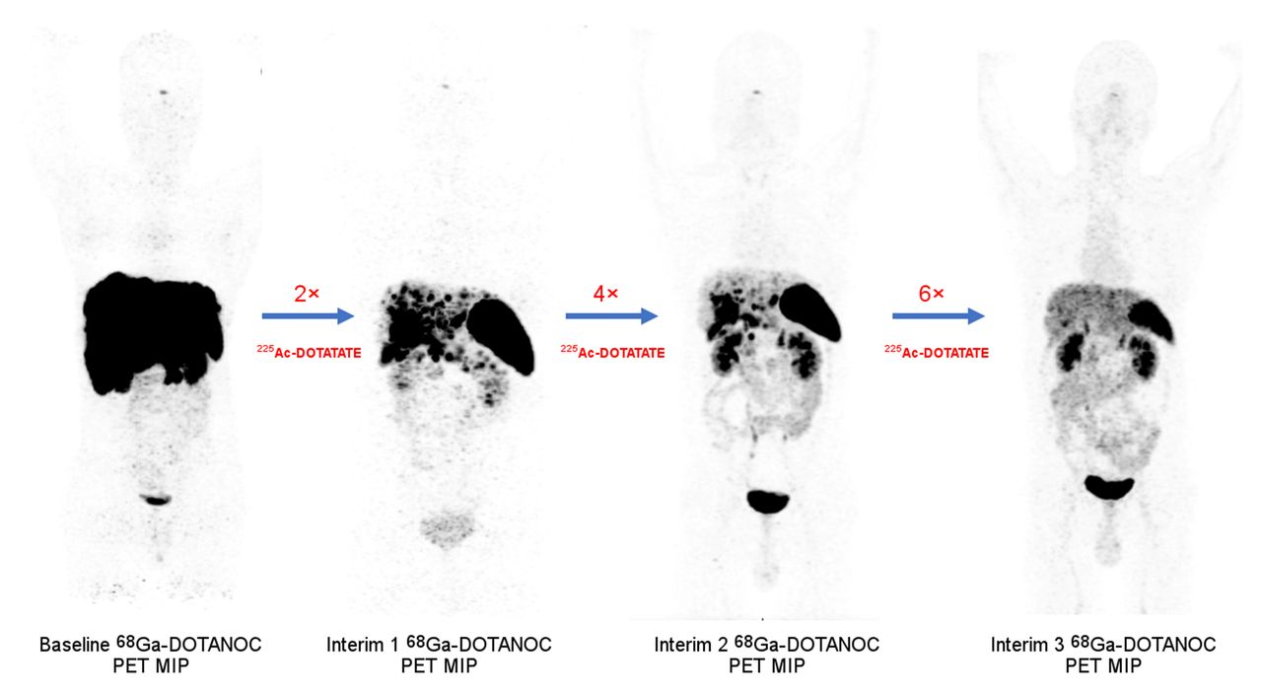
Alpha emitters - Ac-225 DOTATATE
Ballal et al Dehli India JNM 2022
Results of 91 patients treated with multiple cycles of 100-120 kBq Ac-225 DOTATATE 8 weekly
Very mixed patient group though some had “failed” Lu-177 DOTATATE
No median PFS obtained but stated 67% probability it would be >24months

Slide 56

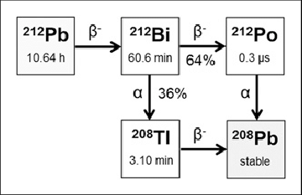
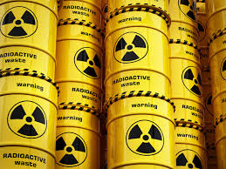
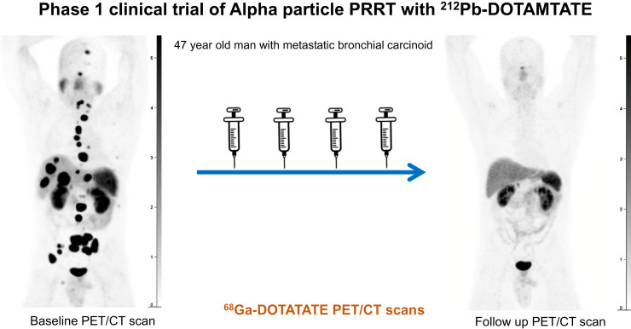
Phase 1 trial of Pb-212 DOTAMTATE
Delpassand et al Houston Texas and RadioMedix JNM 2022
10 patients with NET refractory to Lu-177 DOTATATE treated with 4 cycles of up to 2.5GBq Pb-212 DOTAMTATE
Good early response and low toxicity
Long terms effects not reported

Slide 57
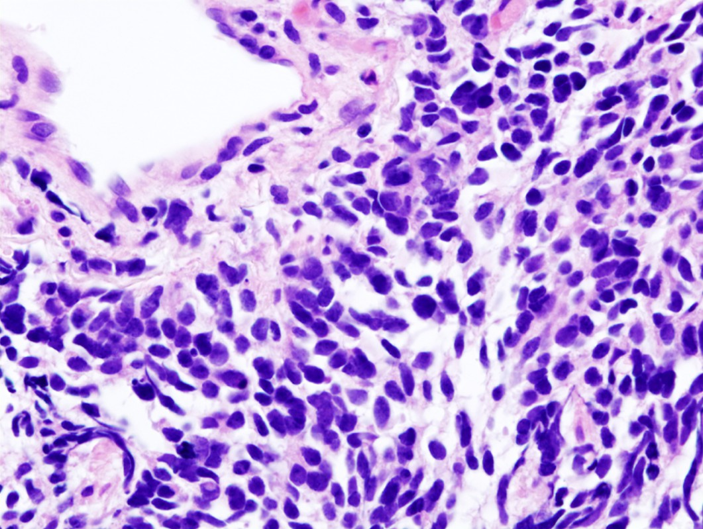
Ac-225 PRRT off in new directions
Ac-225 Satoreotide has been approved for a phase I/II trial in SCLC and Merkel cell cancer in the USA by the FDA
Being run by Ariceum Therapeutics
May be good choice of disease as the renal uptake remains high and if disease has poor prognosis higher toxicity levels are more acceptable
Single patient results published by Tuncel et al from Turkey in EJNMMI 2025
Maybe high risk strategy as many potential new drugs in SCLC in development

Slide 58
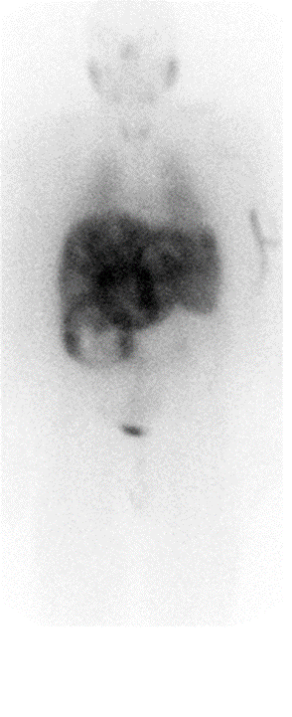
The utility of I-131 mIBG in NETs
What about my old friend mIBG?
Safford S et al in 2004 published review of 98 patients with carcinoid treated with I-131 mIBG
All at Duke Uni, North Carolina
Overall median OS 25 months
However if good symptom relief median OS 57 months
Needed to administer >15GBq I-131 mIBG
CT changes poor predictor of long term survival
Post therapy I-131 mIBG in patient with liver mets from carcinoid – Dr Gnanasegaran

Slide 59
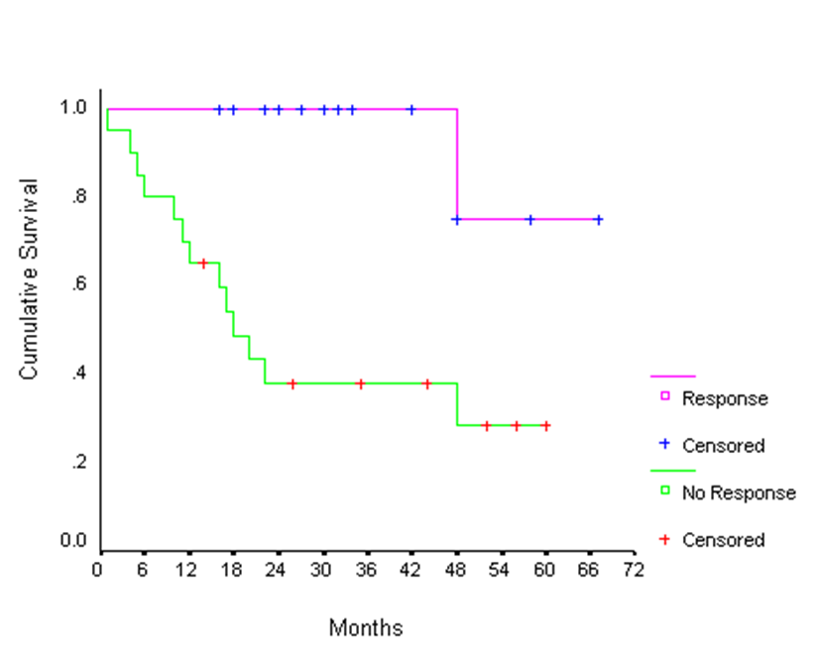
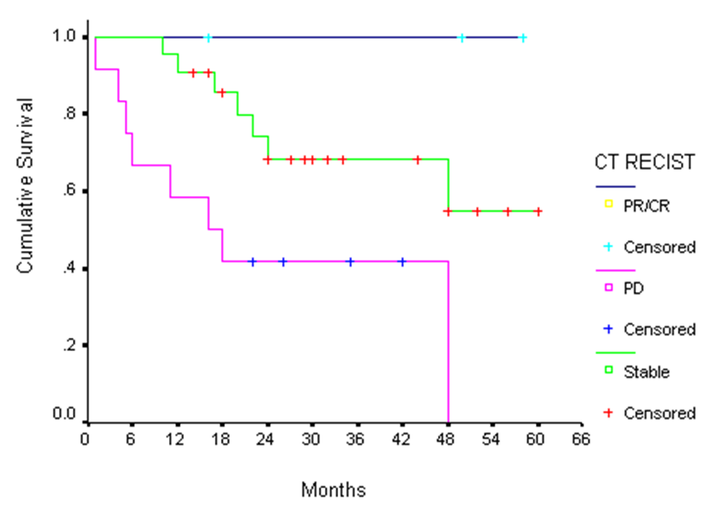
Symptom relief better predictor of survival than changes on CT
Radiological response
Symptom relief
Review of 38 patients with NETs, Pheos and PGomas treated at the Royal Free Hospital shows symptom response and radiological response predict good survival Navilkissoor S et al EJNMMI 2010
Confirmed in study of Thorpe MP et al in 125 patients with Pheos and Pgomas treated with I-131 mIBG at Duke NC, USA JECM 2019

Slide 60

However, are we at the end of the road for I-131 mIBG
Basically an orphan drug
No patent
No ongoing promotion or support
No large scales phase III RCTs
Small market seen as competing with PRRT
Not approved by NICE or recommended in Europe
Production intermittent
Needs in patient care became unpopular
In USA Progenics who made HS I-131 mIBG bought by Lantheus
Shut down production in August 2023

Slide 61


Maybe or maybe not the end of the road
This is iodine
This is Astitine
World facing massive shortage of reactor capabilities for therapy radionuclides but At-211 made in a cyclotron from stable bismuth

Slide 62

Preclinical work with At-211 mABG
Long history of work with At-211 mABG
Mike Zalutsky’s group at Duke University, NC, USA demonstrated long term retention in neuroblastoma cells (BJR 1997)
Batra and colleagues from Uni-Penn investigated At-211 MABG in mouse neurobasloma model showing good efficient and low toxicity Clin Can Res 2022
Oshima et al from Fukishima, Japan showed increased survival of mice treated with At-211 mABG in pheo model EJNMMI 2018
In 2024 launched NIH registered phase 1 trail of At-211 mABG in patients with malignant Phaeo and Pgoma (Plos one) 2024)
2 cc tumour mass
Thin layer tumour
Low dose fractionated vs high single dose mIBG
Batra etal CCR 2022

Slide 63
Summary
Growing evidence of the utility of PRRT
Most evidence for Lu-177 DOTATATE
It appears 80% benefit from PRRT and PFS extended by at least 12 months
May need to select patients carefully
However, to convince the oncology world we need full RCT data
Tandem treatment with chemo/immunotherapy still unproven
New radionuclides/peptides being tested
MABG may also be added to the mix

